Slide 1
Computational Prediction of Boundaries of 3D Genomic Domains in Class Imbalance Settings
Spiro C. Stilianoudakis¹ (stilianoudasc@mymail.vcu.edu)
Mikhail G. Dozmorov¹ (mikhail.dozmorov@vcuhealth.org)
¹Dept. of Biostatistics, Virginia Commonwealth University, Richmond, VA, 23298, USA

Slide 2
Outline
Spatial organization of the human genome
Topologically associated domains (TADs)
Epigenomics
Predicting TAD Boundary Formation
Establishing Ensemble Framework
Relationship between annotations and TADs
Addressing data irregularities and characteristics
Identifying which epigenomic features are most predictive of TADs
Conclusion
Summarizing Results
Discussion
Future Work

Slide 3
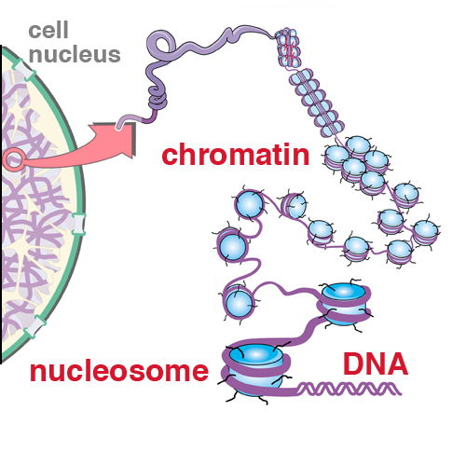
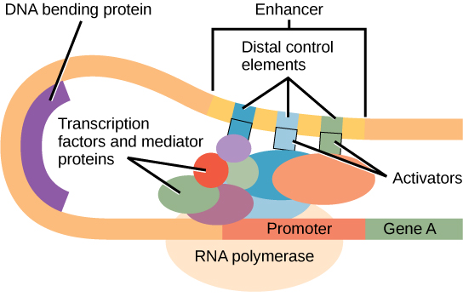
The Human Genome
The genome is composed of 22 pairs of autosomal chromosomes (in addition to a pair of sex chromosomes)
Includes approximately 3 billion base pairs (A/T/C/G)
DNA has been known to create compact loops to fit inside the nucleus of a cell

Slide 4
Chromosome conformation capture techniques
A set of molecular biology methods used to analyze the spatial organization of chromatin in a cell
Quantifies the number of interactions between genomic loci that are nearby in 3-D space, but may be separated by many nucleotides in the linear genome
Hi-C is an extension of previous techniques that is capable of identifying long range interactions in an unbiased, genome-wide fashion

Slide 5
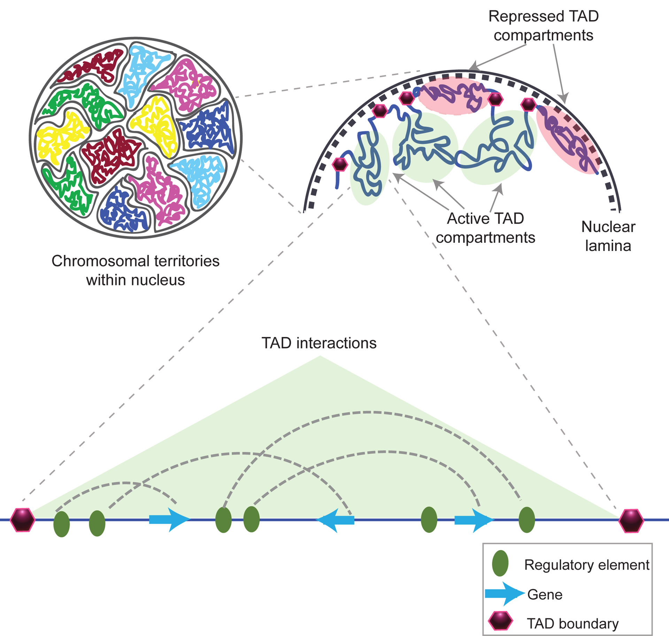
Topologically Associating Domains
Hi-C sequencing technologies have shown that the genome is tightly compacted into distinct compartments termed topologically associating domains (TADs)
The entire genome can be partitioned into two spatial compartments such that greater interaction occurs within each compartment rather than across compartments

Slide 6
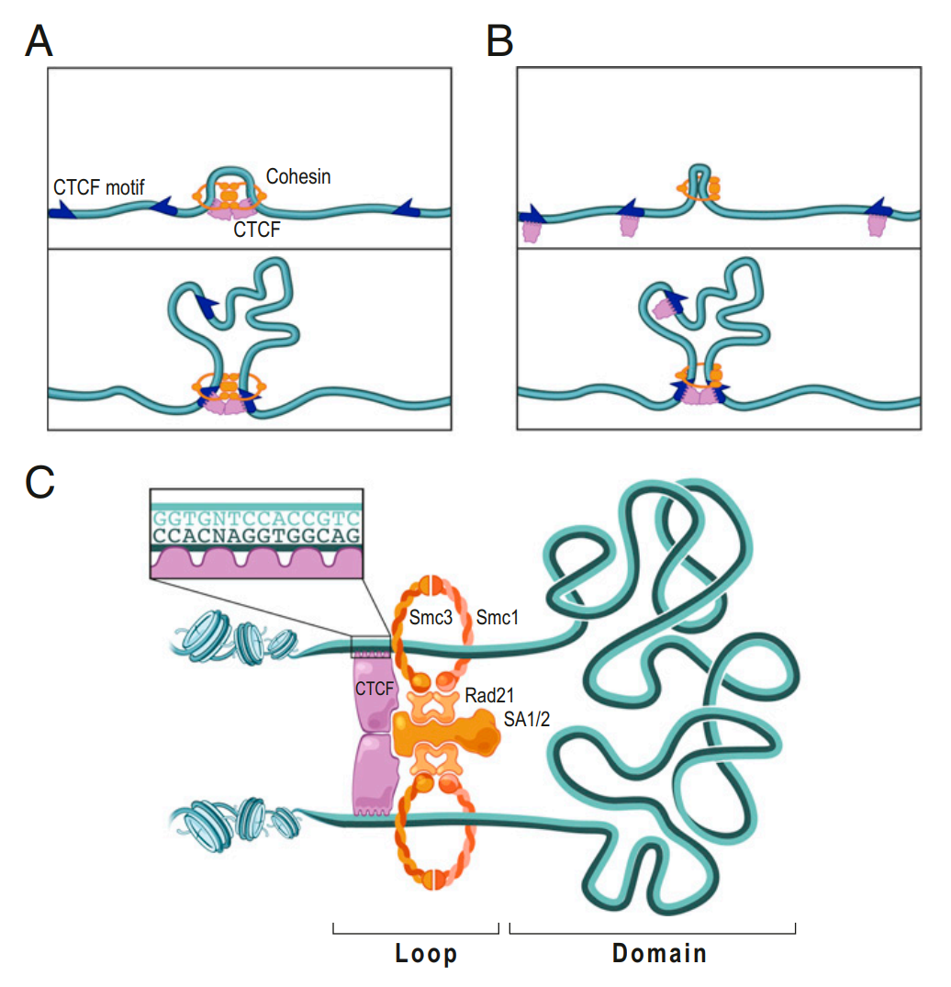
Characteristics of TADs
Evidence suggests that regulatory elements and genes tend to interact more frequently within the same TAD.
Boundaries of TADs may play a role in restricting the function of certain genomic elements such as enhancers, thereby impacting the transcription of genes.
Approximately 60-80% of TADs remain stable across cell types.
Studies have shown that changing the 3D structure of the DNA, causing disruptions in these domains, can lead to adverse outcomes and diseases like cancer.
It is unclear what the complete set of genomic-specific features are that correlate with TAD boundaries

Slide 7
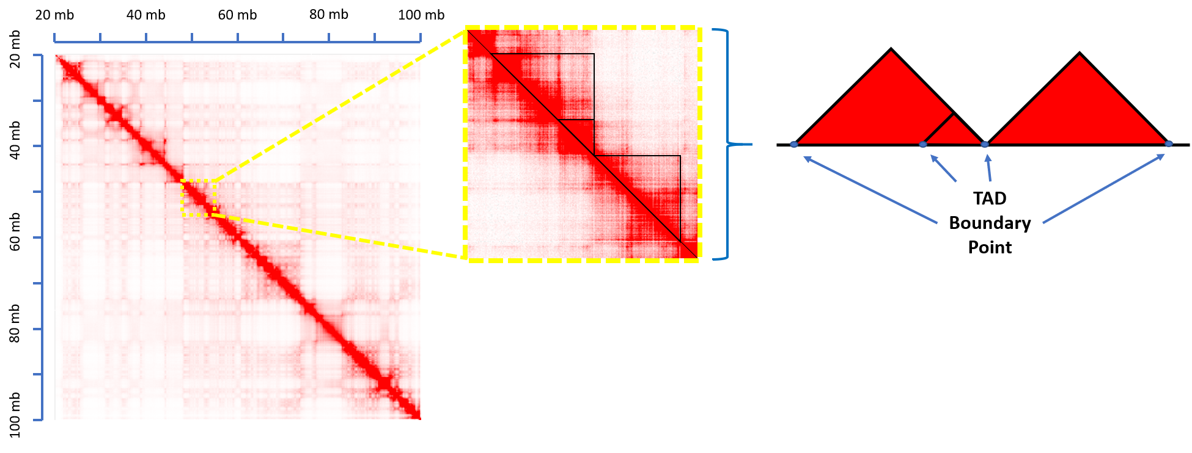
Visualizing TADs
TAD Calling Algorithms are used to delineate the regions on the linear genome that define a TAD.
The partitioning of the genome into TADs is hierarchical in nature
Many different algorithms have been proposed for identifying TADs from Hi-C data

Slide 8
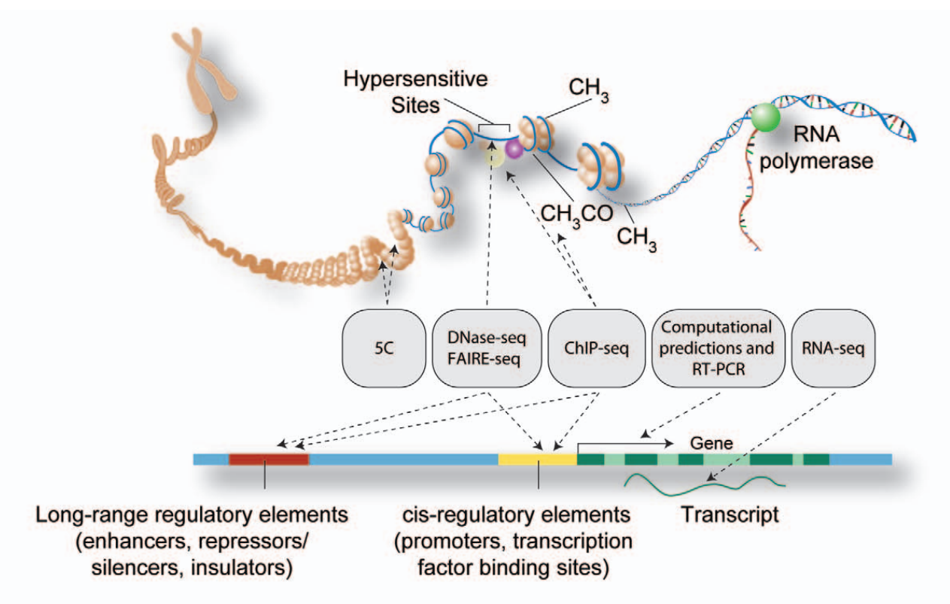
Relating TAD Boundaries to Epigenomic Functions
Epigenomics is the study of the complete set of molecular modifications that contribute to differential functionality in the genome
Protein coding genes only account for about 1% of the DNA sequences in the human genome.
They provide an opportunity to identify and understand how chromosomal structures act throughout the other 99% of the genome
Consists of chromatin states, histone modifications, transcription factor binding sites, DNAse I hypersensitive sites, etc.
Notes:
Combines chromatin immunoprecipitation (ChIP) with massively parallel DNA sequencing
Determines how transcription factors and other chromatin-associated proteins influence phenotype-affecting mechanisms

Slide 9
Using Epigenomic Annotations to Predict TAD Formation
We aim to create a classification algorithm that efficiently and correctly identifies the functional genomic elements most predictive of the formation of TAD boundaries
Create and ensemble framework in which we answer the following questions:
How severe is class imbalance?
What type of predictors improve model performance?
Which functional genomic elements are most predictive of TAD boundaries?

Slide 10
Domain Data Source
Publicly available Replicate Hi-C data was obtained for the GM12878 and K562 cell lines from Rao et al. 2014 (GEO GSE63525)
The autosomal genomic coordinates (GRCh37/hg19 human genome assembly) of TAD boundaries were obtained from data at 10 kb, 25 kb, 50 kb, and 100 kb resolution using the Arrowhead algorithm (developed by Rao et. al (2014))

Slide 11
Genomic Annotation Data Source
Genomic annotation data were obtained from the UCSC Genome Browser Database
Consisted of over a hundred different combinations of the following cell type-specific:
Chromatin states
Histone marks
Transcription factor binding sites
DNAse Hypersensitive Sites

Slide 12
Model Construction Outline
Establishing the Response
Feature Engineering
Quantifying the relationship between annotations and TAD boundaries
Addressing class imbalance using different re-sampling techniques
Feature Reduction
Classification & Validation
Measuring Performance

Slide 13
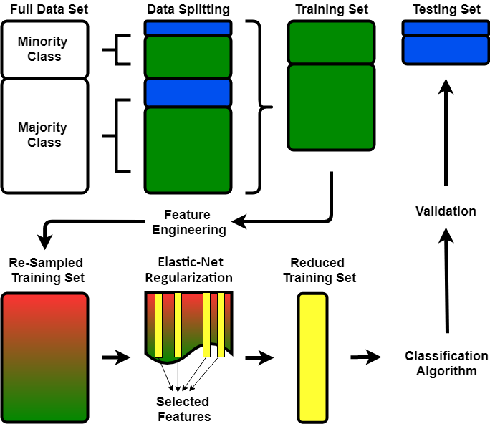
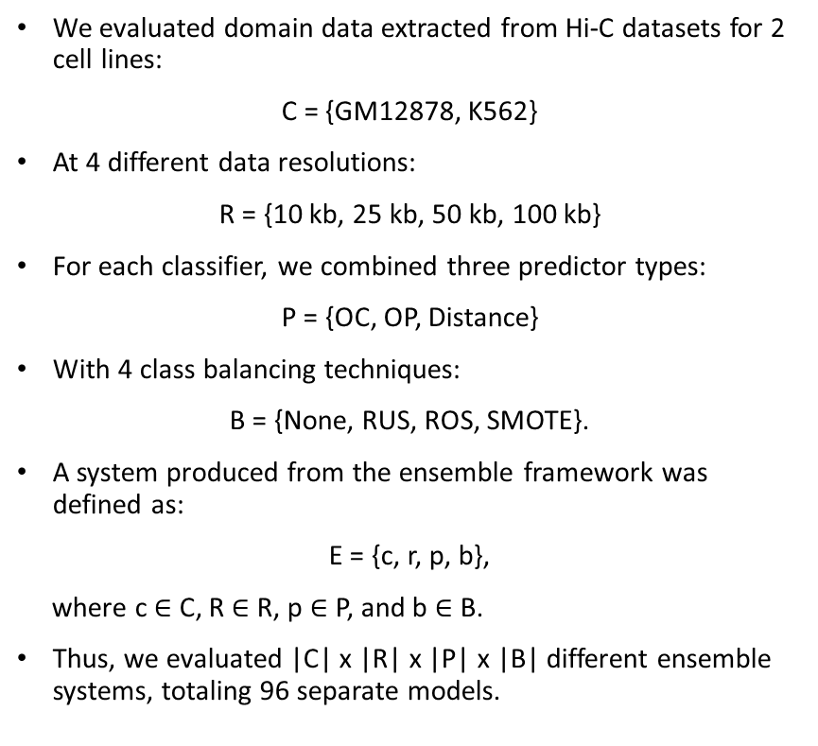
Forming an Ensemble Framework
We evaluated domain data extracted from Hi-C datasets for 2 cell lines:
C = {GM12878, K562}
At 4 different data resolutions:
R = {10 kb, 25 kb, 50 kb, 100 kb}
For each classifier, we combined three predictor types:
P = {OC, OP, Distance}
With 4 class balancing techniques:
B = {None, RUS, ROS, SMOTE}.
A system produced from the ensemble framework was defined as:
E = {c, r, p, b},
where c $∈$ C, R $∈$ R, p $∈$ P, and b $∈$ B.
Thus, we evaluated |C| x |R| x |P| x |B| different ensemble systems, totaling 96 separate models.

Slide 14
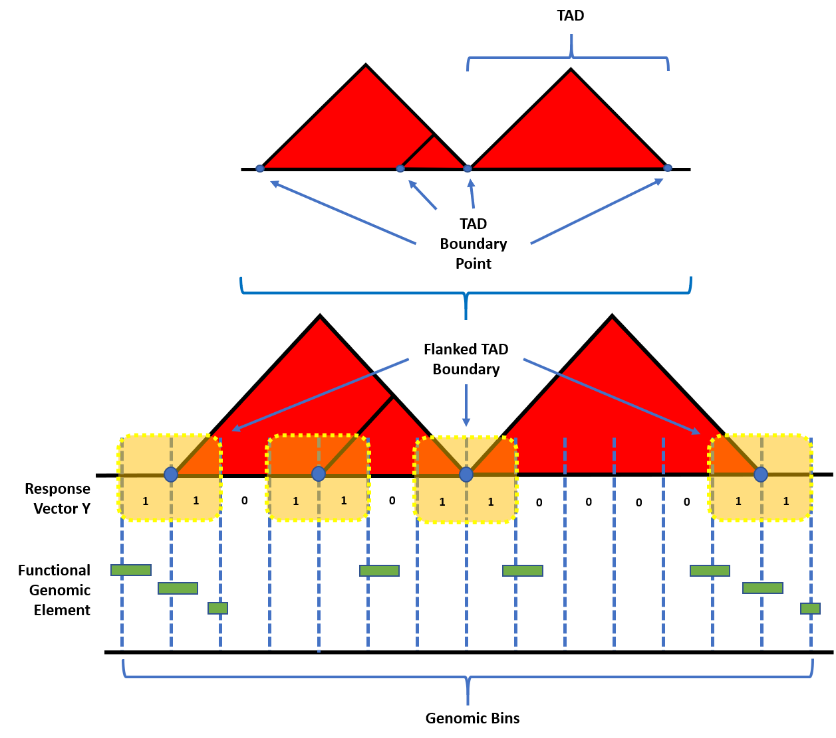
Establishing the response
Identified TAD boundaries were represented by their starting and ending coordinates in the linear genome.
The genomic coordinates of all TADs were concatenated, sorted, and unique TAD boundary points were obtained.
In order to accommodate for the uncertainty in exact boundary location, the boundary points were flanked on both sides by the size of the resolution of the corresponding contact matrix.

Slide 15
Establishing the response
The genome was binned into equally sized intervals defined by the data resolution for the corresponding contact matrix.
A genomic bin was labeled as having a TAD boundary within it (Y=1) if it overlapped with a particular flanked boundary. Otherwise, the bin was labeled as not containing a boundary (Y=0).

Slide 16
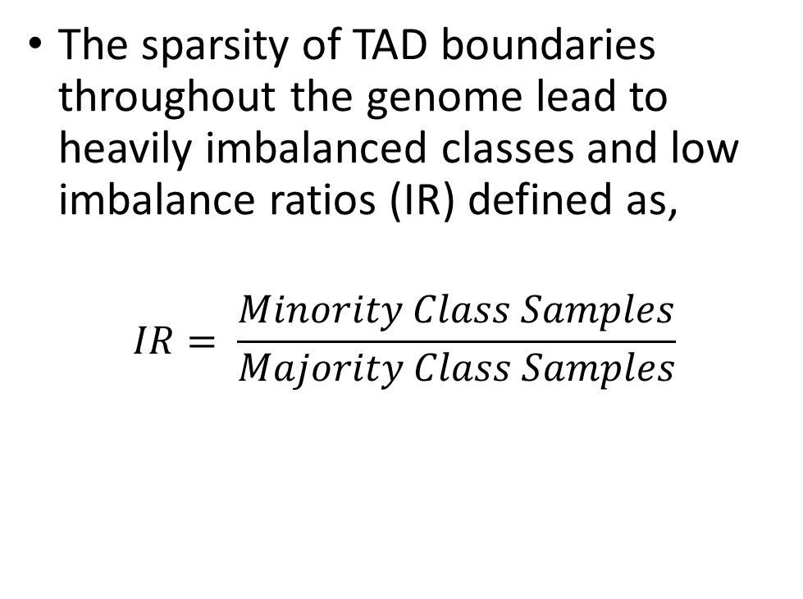
Establishing the response
The sparsity of TAD boundaries throughout the genome lead to heavily imbalanced classes and low imbalance ratios (IR) defined as,
$$IR= \frac{Minority Class Samples}{Majority Class Samples}$$

Slide 17
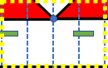
Predictor Types
Overlap Counts (OC):
The total number of instances where a genomic bin overlapped with regions assigned to genomic annotations (features). In the case of no overlaps, the value was set to 0.
1
0
1
1

Slide 18
Predictor Types
Overlap Percents (OP):
The percent of overlap between the width of the region assigned to a genomic annotation and the total width of the bin (in basepairs). The percent was then calculated by dividing the feature width by the bin width.
Feature Width
Bin Width

Slide 19
Predictor Types
Log₂ Distance:
The log₂ of the distance (in basepairs; referred to hereafter simply as distance), from the center of the bin to the center of the nearest region defined by a specific genomic annotation.
D₁
D₂
D₃
D₄

Slide 20
Re-sampling Techniques
In order to assess the influence of imbalanced classes, we then evaluated four re-sampling techniques (in addition to no re-sampling), composed of data from each predictor type.
No Sampling: All of the data points from the majority and minority class of the training set were used.

Slide 21
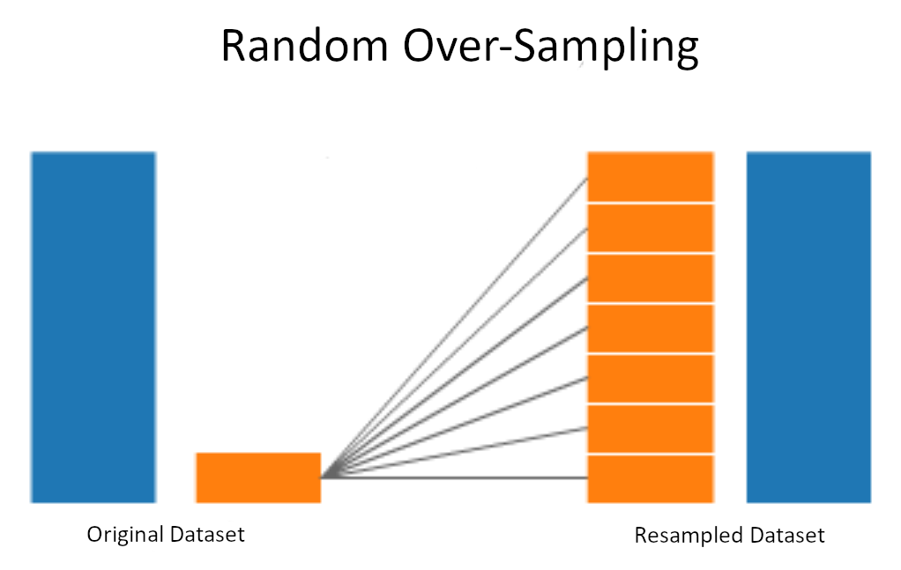
Re-sampling Techniques
Random Over-Sampling (ROS): All of the majority classes from the training set were used. Sampling with replacement was used to obtain the same number of the minority classes.

Slide 22
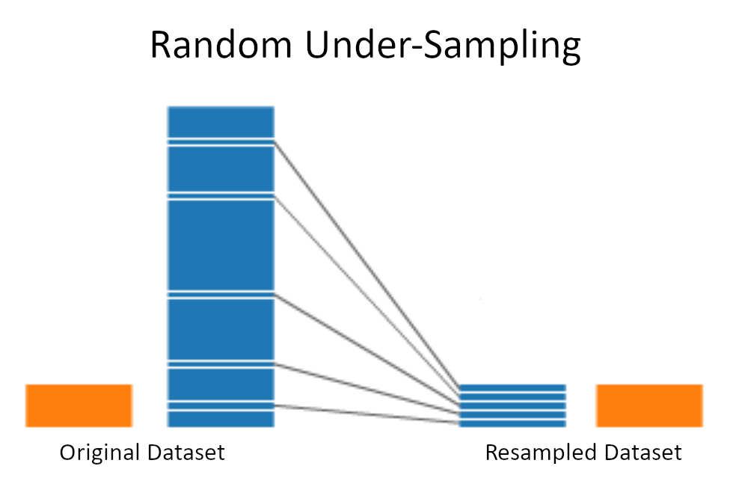
Re-sampling Techniques
Random Under-Sampling (RUS): All of the minority classes from the training set were used. Sampling without replacement was used to obtain the same number of the majority classes.

Slide 23
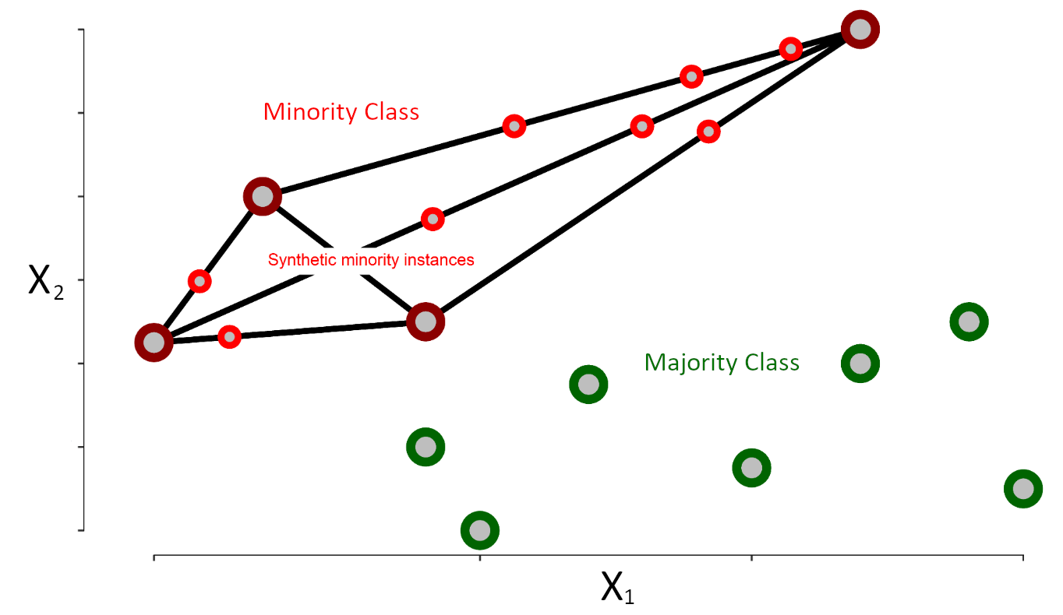
Re-sampling Techniques
SMOTE (Synthetic Minority Over-Sampling Technique): Incorporates both random under- and over-sampling. Under-sampling is performed without replacement from the majority class, while over-sampling is performed by creating new synthetic observations using the minority class. The DMwR R package was used to perform SMOTE (version 0.4.1).

Slide 24
Feature Reduction
To reduce model complexity and improve computational efficiency an Elastic-Net regularization algorithm was performed
Using a combination of the L₁ and L₂ norm penalties suitably reduced aberrant noise in the model while also maintaining possibly colocalized genomic features near TAD boundaries
10-fold cross-validation was used to tune the parameters that controlled the penalty terms

Slide 25
Classification
Random forest classification models were performed to predict TAD boundary formation using genomic annotations
To reduce bias due to random dataset generation, 10-fold cross validation was used to tune the number of features to consider at each node and the number of ensemble trees to aggregate.

Slide 26
Measuring Model Performance
Once the model was implemented, it was assessed using the test set, and performance metrics were recorded.
Commonly used measures of model performance for binary classifiers include threshold-free metrics like the area under the receiver operating curve (AUROC), and other threshold-specific metrics like accuracy, sensitivity, and specificity.
Problems arise when using such measures in the event of imbalanced classes.
Better measures to consider are composite metrics involving both precision and recall together because they soften the influence of a model's ability to correctly classify majority classes and yield more dependable and interpretable results.

Slide 27
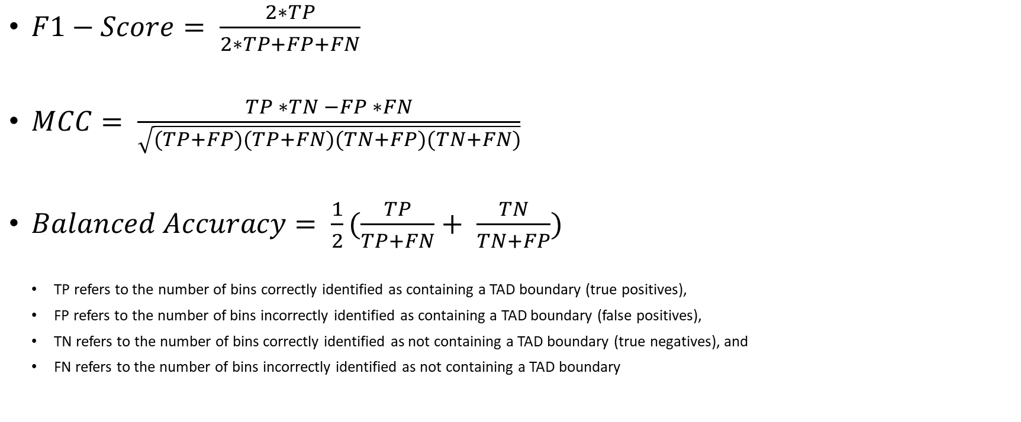
Measuring Model Performance
$F1−Score= \frac{2∗TP}{2∗TP+FP+FN}$
$MCC= \frac{TP ∗TN −FP ∗FN}{\sqrt{(TP+FP)(TP+FN)(TN+FP)(TN+FN)}}$
$Balanced Accuracy= \frac{1}{2}(\frac{TP}{TP+FN}+ \frac{TN}{TN+FP})$
TP refers to the number of bins correctly identified as containing a TAD boundary (true positives),
FP refers to the number of bins incorrectly identified as containing a TAD boundary (false positives),
TN refers to the number of bins correctly identified as not containing a TAD boundary (true negatives), and
FN refers to the number of bins incorrectly identified as not containing a TAD boundary

Slide 28
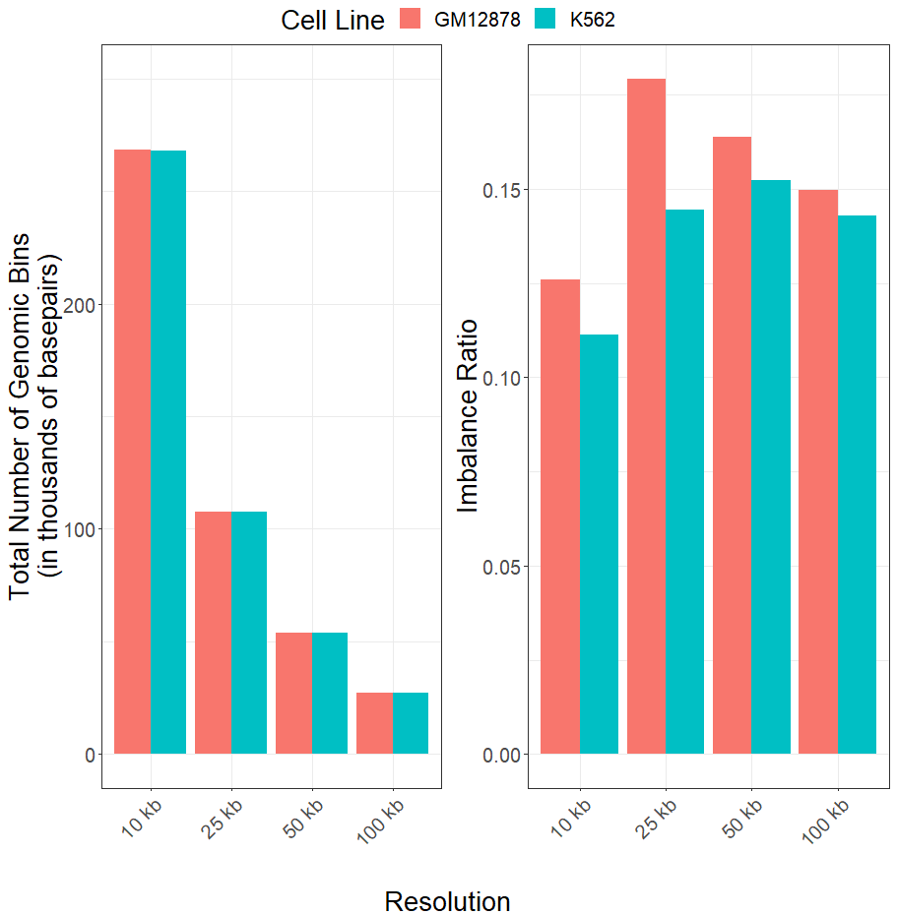
Imbalance Ratios Remained Severe & Consistent Across Resolutions
We first examined the class imbalance of the different data resolutions for each cell line.
The total number of genomic bins decreased as resolution increased
Average imbalance ratios were 0.154 (SD=0.022) and 0.137 (SD=0.0181) across resolutions for the GM12878 and K562 cell lines respectively

Slide 29
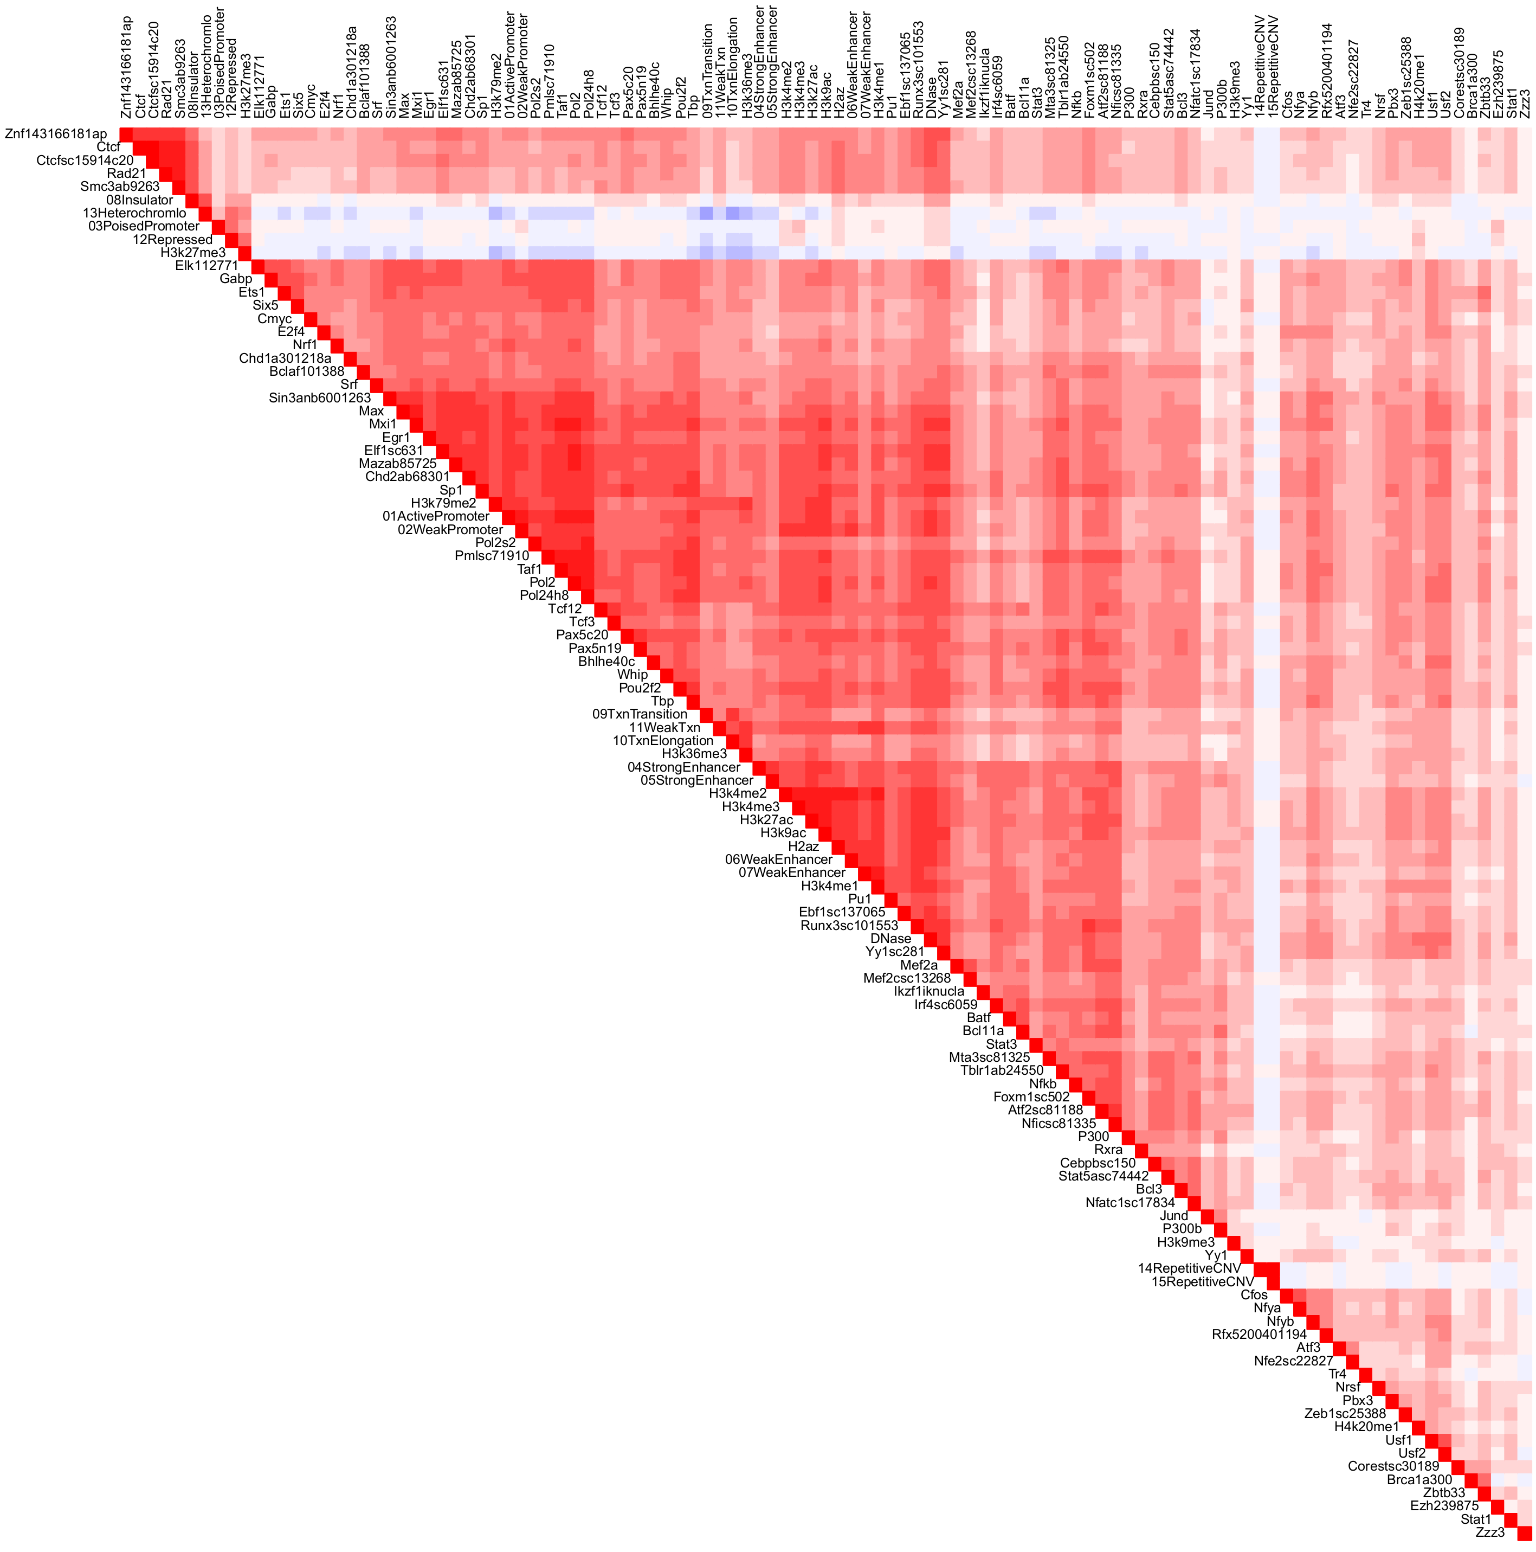
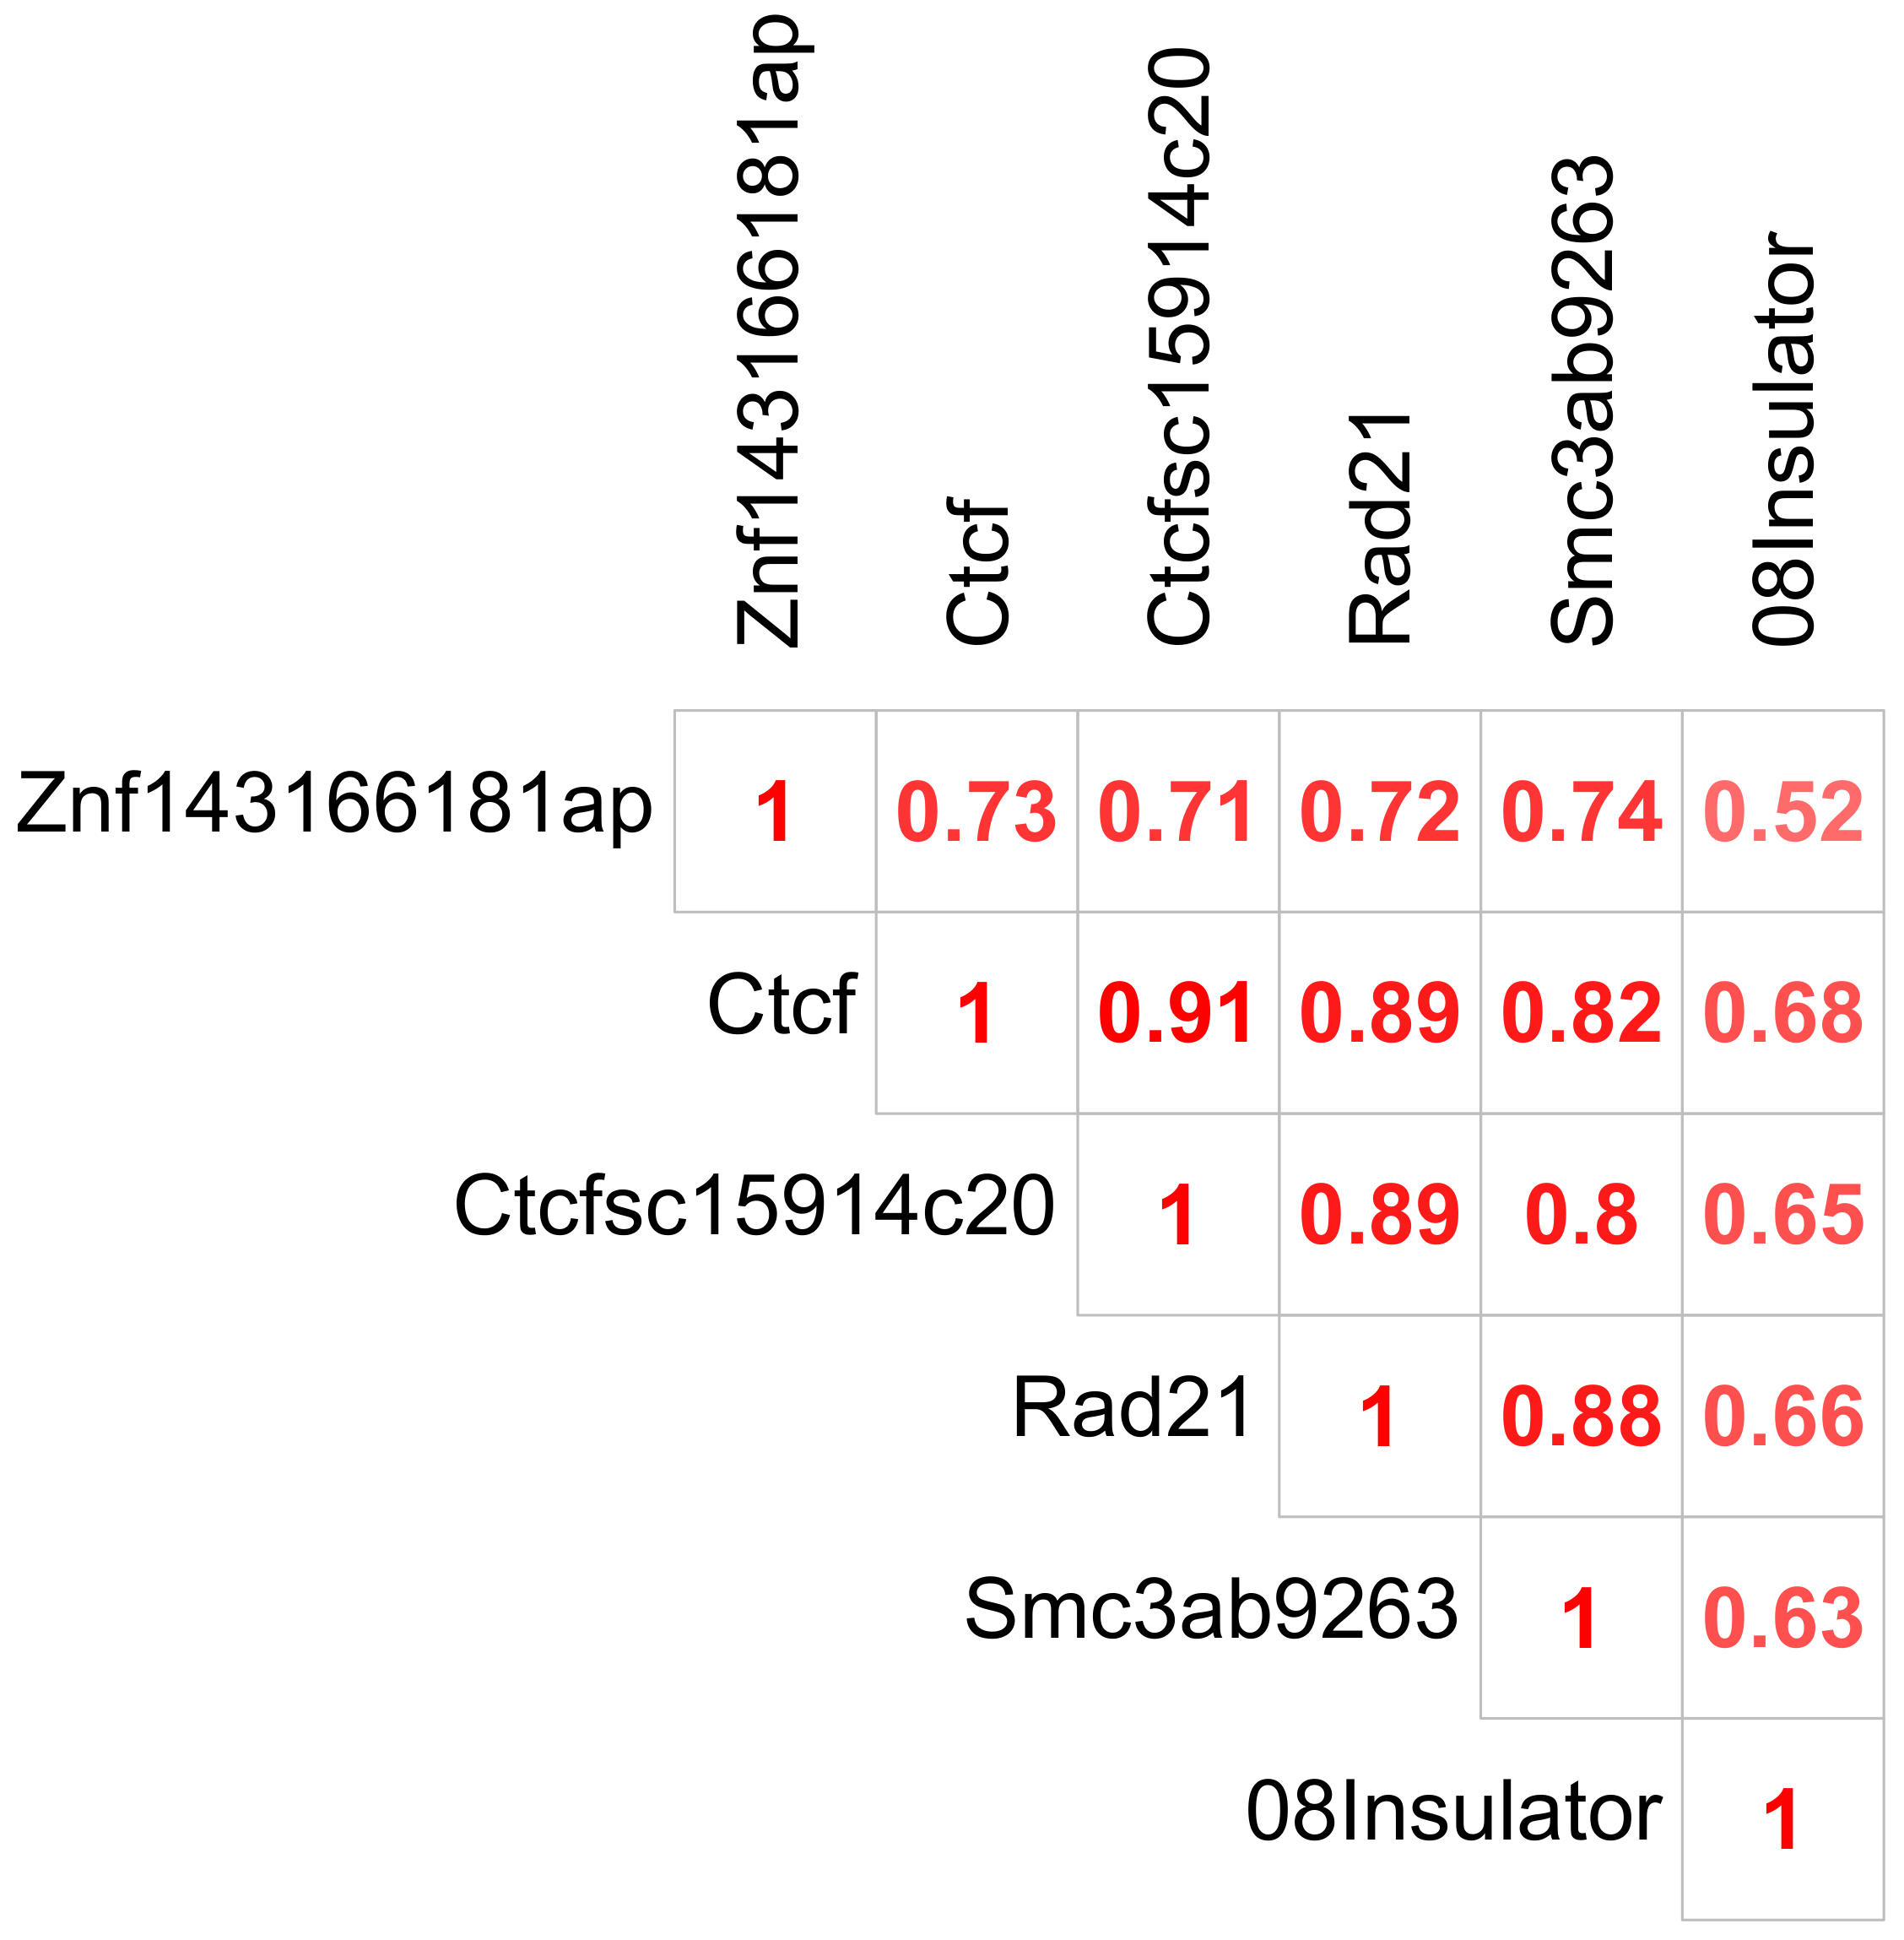
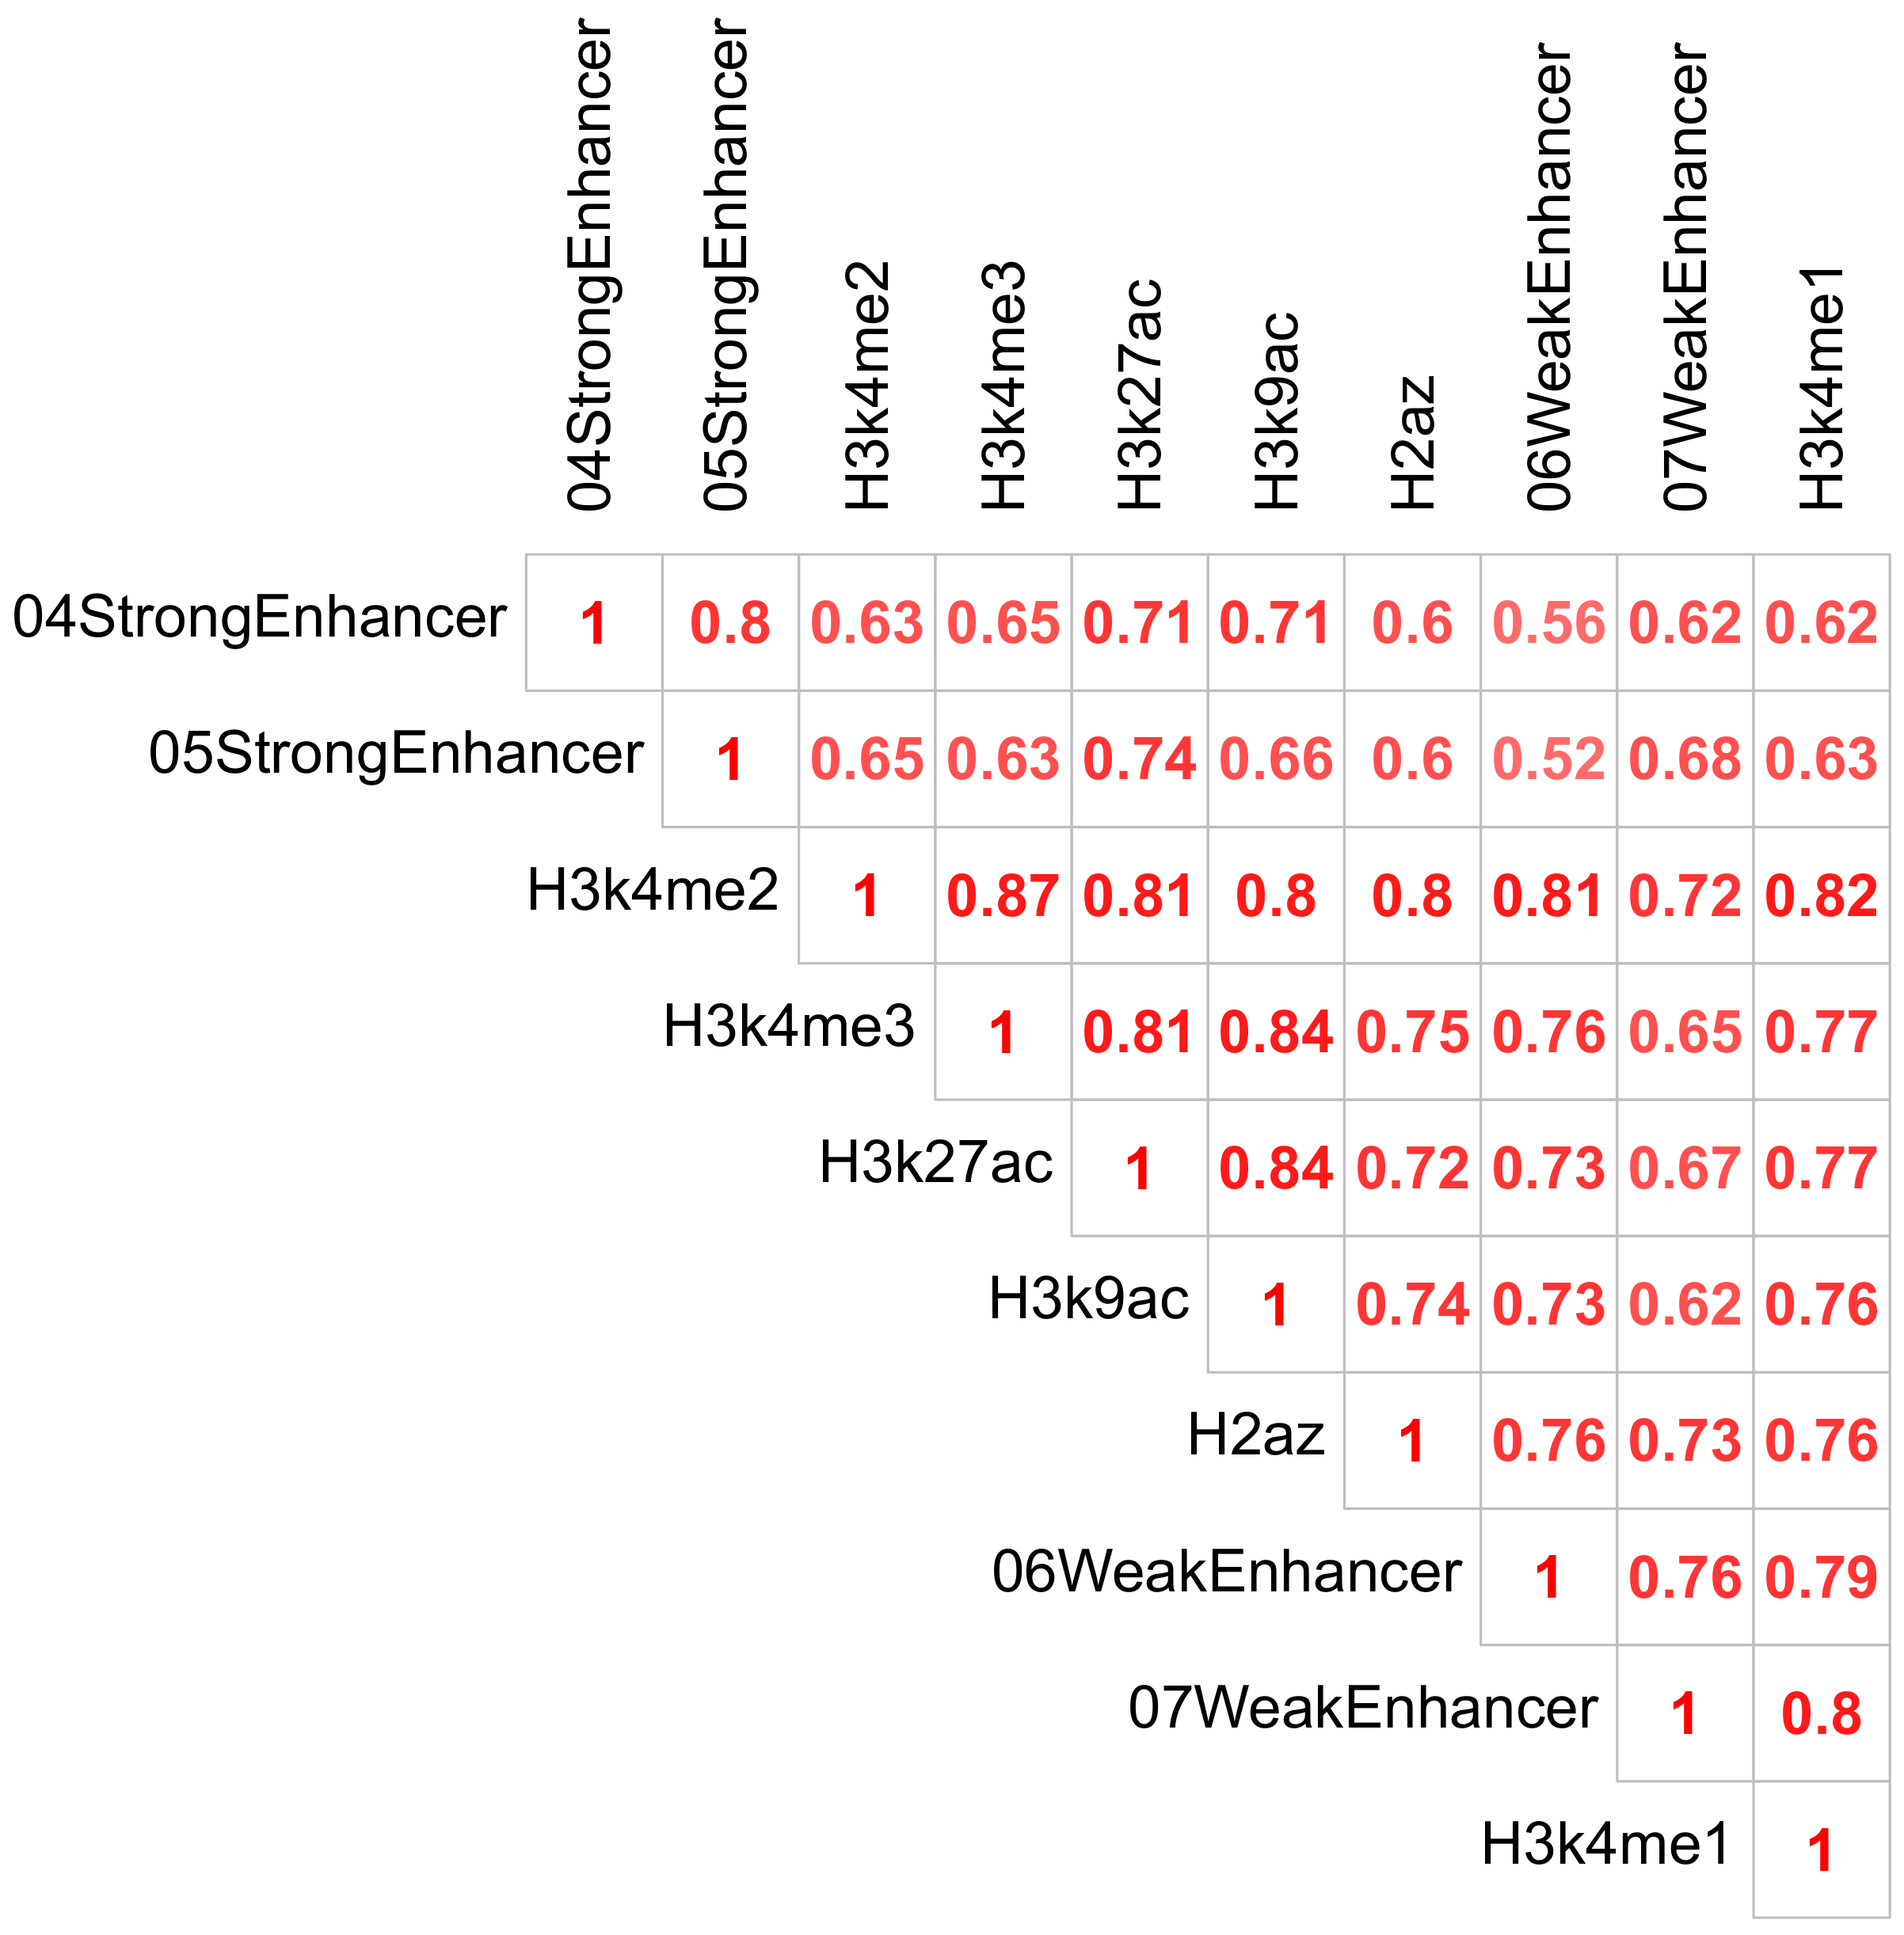
High Correlations Imply Many Colocalized Annotations Around TAD Boundaries

Slide 30
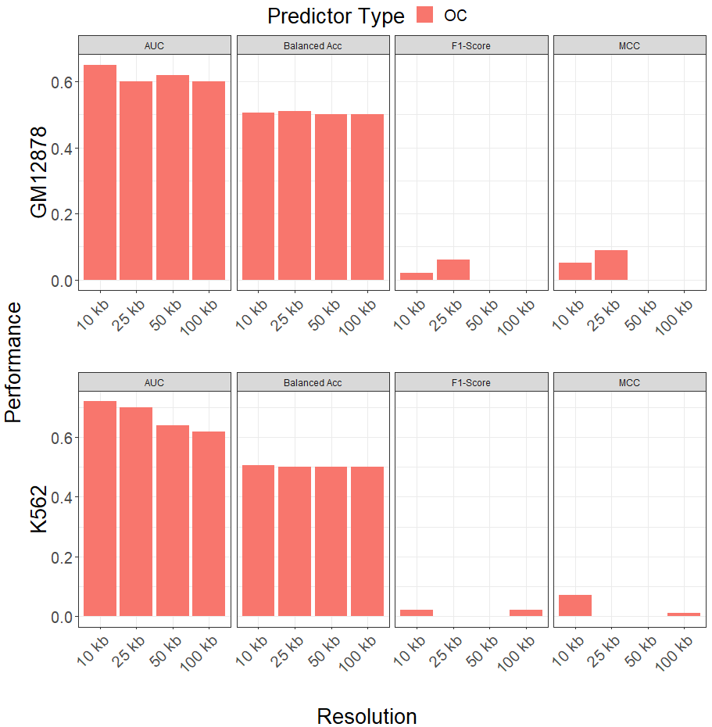
Class Imbalance Severely Impacts Model Performance Across Resolutions
We first evaluated model performances using count overlap predictor types without re-sampling
Conventional metrics are unable to accurately describe poor performance
Some models at higher resolutions are unable to correctly predict bins that overlap with flanked TAD boundaries

Slide 31
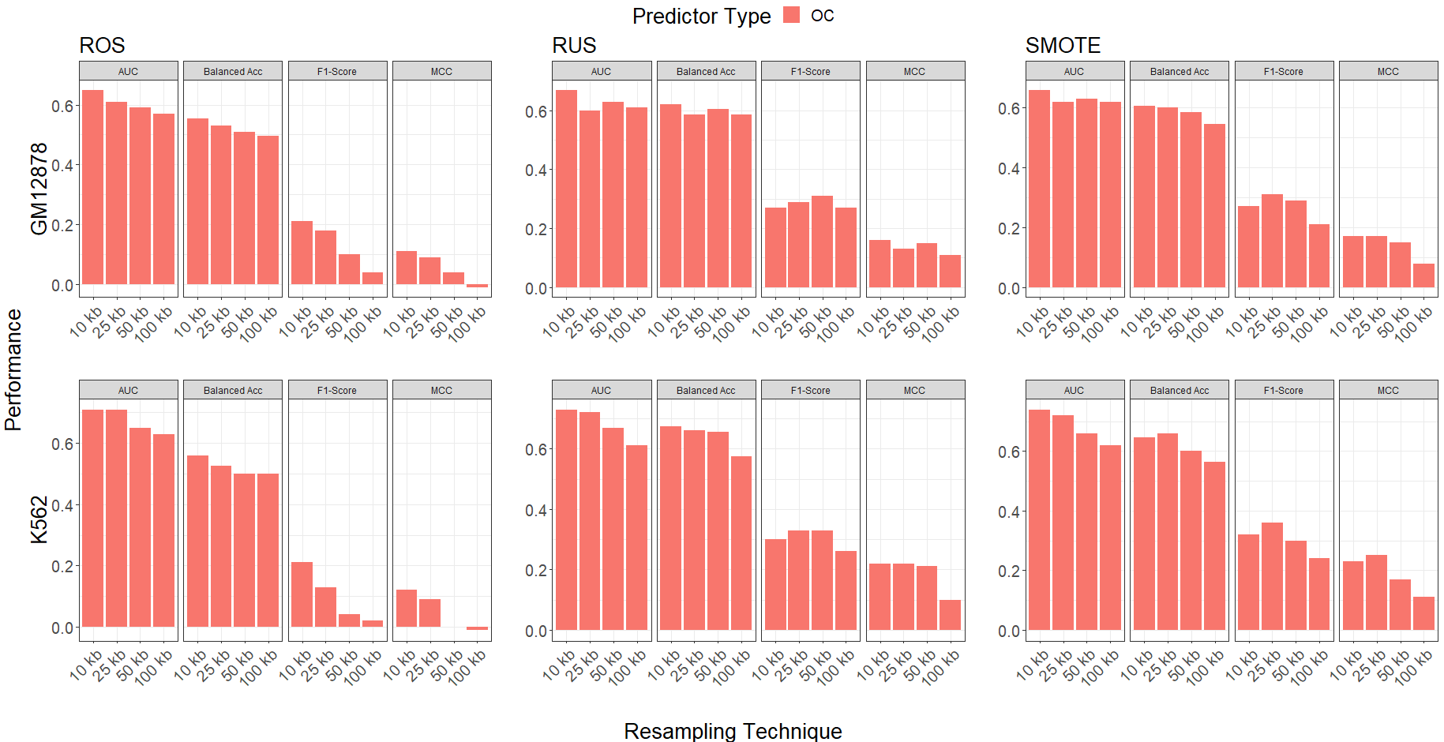
Data Re-Sampling Improves Model Performance
Using balanced metrics shows improvement in model performance after creating balanced classes
Conventional metrics remain invariant
Performances appear to degrade as resolution decreases

Slide 32
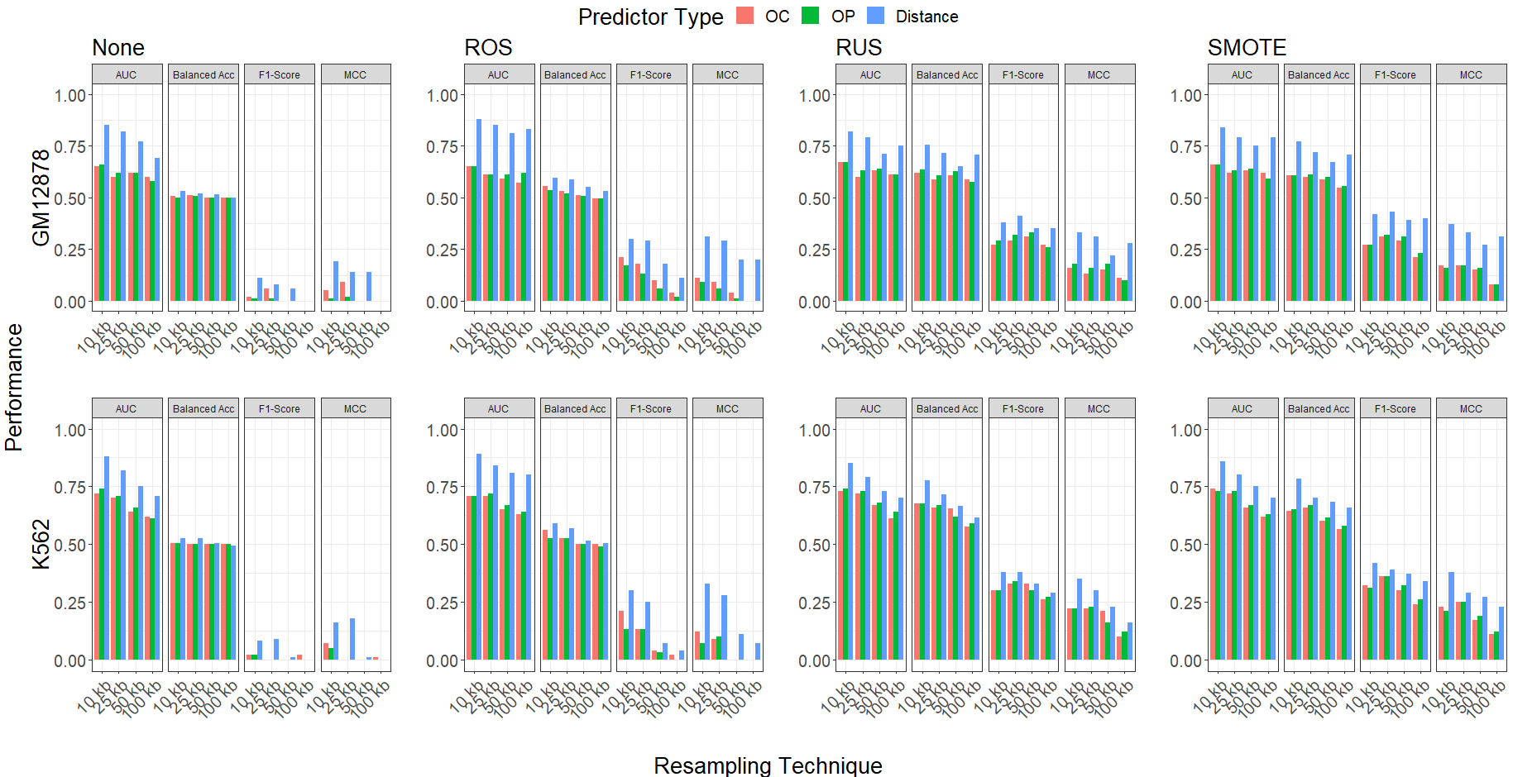
Using Distance-Type Predictors Further Improves Model Performance
Models with distance type predictors outperform models with other predictor types
Performances continue to degrade as resolution decreases
Results are consistent across resampling technique, data resolution, and cell line

Slide 33
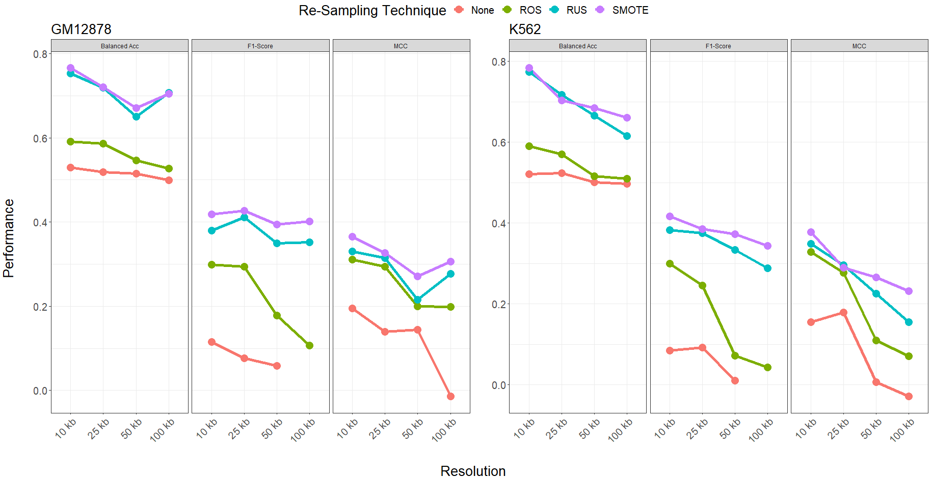
Models Implemented on SMOTE Re-Sampled Data with Distance-Type Predictors Performed Best Among ALL Ensemble Systems
A mixture between random over and under-sampled data resulted in better performances
Results were consistent across resolution and cell line
Higher resolutions corresponded to better performances

Slide 34
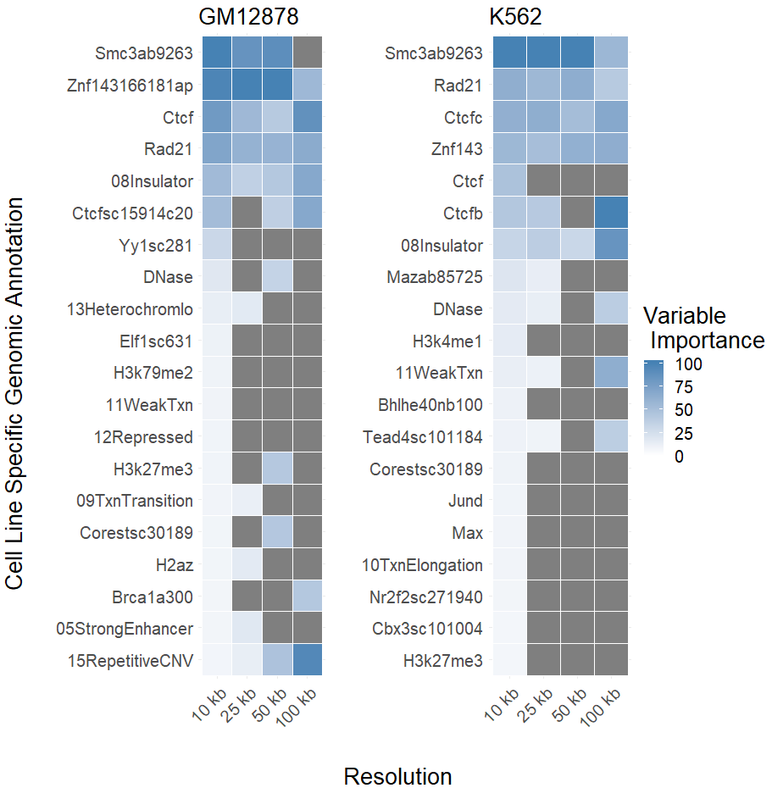
Variable Importances Confirm Biological Functionality of Known Genomic Annotations
TFBS associated with hypothesized loop extrusion model are give high predictive importance in the model
A combination of chromatin states, histone modification, and DNAse I hypersensitive sites were found to have high importance for both cell lines
Agreement of importance rankings between resolutions decrease as resolution decreases
Lower resolutions may not be able to capture enriched genomic annotations at TAD boundaries

Slide 35
In Summary
We developed an ensemble framework to directly compare models implemented on a variety of different data-level characteristics.
Applications of this framework indicated that applying class balancing techniques on training data prior to modelling improved performance.
Specifically, a combination of random over- and under-sampling was shown to exhibit best performances across all of the metrics considered.
Comparisons of different performance metrics showed the importance of using composite metrics when validating models on imbalanced data
Furthermore, models built on (log₂) distance-type predictors, in combination with data re-sampling, outperformed other predictor types.
Performances worsened as resolution decreased
Variable importances point toward some confirmed and unconfirmed annotations associated with TAD boundaries

Slide 36
In Summary
CTCF, SMC3, and RAD21 are components of the cohesion complex
ZNF143 and YY1 are associated with contributing to interactions between promotors and distal enhancers, thereby a key component of the 3D structure of chromatin
Insulator binding sites contribute to chromatin looping domains by blocking enhancer-promotor interactions
Interestingly, most histone modifications were found to either not be highly predictive of TAD boundaries or inconsistent across resolutions
Other chromatin states exhibited similar inconsistent profiles including regions of heterochromatin and repressed chromatin

Slide 37
Discussion
Our ensemble can be extended to compare other:
Re-sampling techniques
Genomic annotations
Data resolutions
Cell lines
The extent of improved performance is contingent on the choice of classification algorithm
Other algorithm-level solutions exist to combat class imbalance

Slide 38
Concluding Remarks
We are just starting to understand the nature of TADs and their boundaries and therefore many questions remain unanswered.
Identifying which genomic annotations are associated with TAD boundary formation can lead to better insight of how diseases develop.
Our framework provides a useful comparison of data-level techniques that can be used to accurately and efficiently predict TAD boundary formation using genomic annotations

Slide 39
References
Tan, Song. “Chromatin Enzymes.” Tan Lab at Penn State, www.personal.psu.edu/sxt30/projects_chromatinenzymes.html.
Lumen Learning, and Houston Community College. “Biology for Non-Majors I.” Lumen, courses.lumenlearning.com/wm-nmbiology1/chapter/reading-eukaryotic-transcription-gene-regulation/
Lieberman-Aiden, E., Van Berkum, N. L., Williams, L., Imakaev, M., Ragoczy, T., Telling, A., ... & Sandstrom, R. (2009). Comprehensive mapping of long-range interactions reveals folding principles of the human genome. science, 326(5950), 289-293.
Matharu, Navneet, and Nadav Ahituv. "Minor loops in major folds: enhancer–promoter looping, chromatin restructuring, and their association with transcriptional regulation and disease." PLoS genetics 11.12 (2015): e1005640.
ENCODE Project Consortium. "A user's guide to the encyclopedia of DNA elements (ENCODE)." PLoS biology 9.4 (2011): e1001046.
Neva C. Durand*, James T. Robinson*, Muhammad S. Shamim, Ido Machol, Jill P. Mesirov, Eric S. Lander, and Erez Lieberman Aiden. "Juicebox provides a visualization system for Hi-C contact maps with unlimited zoom."Cell Systems 3(1), 2016.
James T. Robinson, Douglass Turner, Neva C. Durand, Helga Thorvaldsdóttir, Jill P. Mesirov, Erez Lieberman Aiden. "Juicebox.js Provides a Cloud-Based Visualization System for Hi-C Data." Cell Systems 6(2), 2018.
Lupiáñez, Darío G., Malte Spielmann, and Stefan Mundlos. "Breaking TADs: how alterations of chromatin domains result in disease." Trends in Genetics 32.4 (2016): 225-237.
Sanborn, Adrian L., et al. "Chromatin extrusion explains key features of loop and domain formation in wild-type and engineered genomes." Proceedings of the National Academy of Sciences 112.47 (2015): E6456-E6465.
Huang, Jialiang, et al. "Predicting chromatin organization using histone marks." Genome biology 16.1 (2015): 162.
Weintraub, Abraham S., et al. "YY1 is a structural regulator of enhancer-promoter loops." Cell 171.7 (2017): 1573-1588.
Zhou, Jian, and Olga G. Troyanskaya. "Global quantitative modeling of chromatin factor interactions." PLoS computational biology 10.3 (2014): e1003525.
Lusa, Lara. "Class prediction for high-dimensional class-imbalanced data." BMC bioinformatics 11.1 (2010): 523.
Gonzalez, David, et al. "ZNF143 protein is an important regulator of the myeloid transcription factor C/EBPα." Journal of Biological Chemistry 292.46 (2017): 18924-18936.
Heidari, Nastaran, et al. "Genome-wide map of regulatory interactions in the human genome." Genome research 24.12 (2014): 1905-1917.
Hong, Seungpyo, and Dongsup Kim. "Computational characterization of chromatin domain boundary-associated genomic elements." Nucleic acids research 45.18 (2017): 10403-10414.
Flavahan, William A., et al. "Insulator dysfunction and oncogene activation in IDH mutant gliomas." Nature 529.7584 (2016): 110.
Mourad, Raphael, and Olivier Cuvier. "Computational identification of genomic features that influence 3D chromatin domain formation." PLoS computational biology 12.5 (2016): e1004908.

Slide 40
Thank you!
Any Questions?

